Slide 1

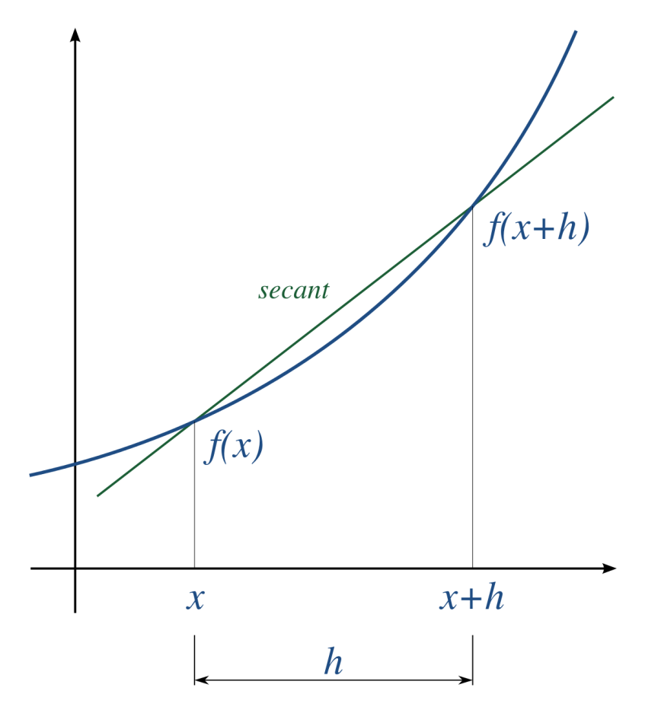
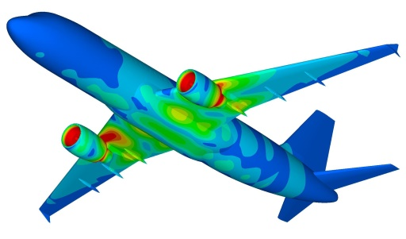
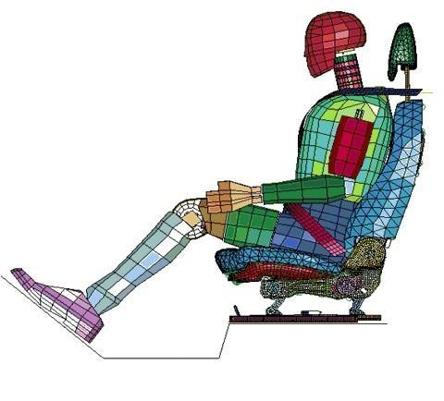
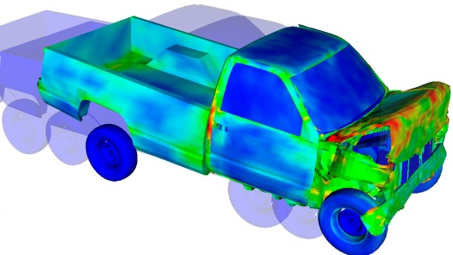
Numerical Differentiation
Dr. Himanshu Pathak
himanshu@iitmandi.ac.in

Slide 2
Introduction
Calculus is the mathematics of change. Because engineers must continuously deal with systems and processes that change, calculus is an essential tool of engineering.
Standing in the heart of calculus are the mathematical concepts of differentiation and integration:

Slide 3
Introduction
Integration and differentiation are closely linked processes. They are, in fact, inversely related.
Types of functions to be differentiated or integrated:
Simple polynomial, exponential, trigonometric ➔ analytically
Complex function ➔ numerically
Tabulated function of experimental data ➔ numerically

Slide 4
Applications
Differentiation has so many engineering applications (heat transfer, fluid dynamics, chemical reaction kinetics, etc…)
Integration is equally used in engineering (compute work in ME, nonuniform force in SE, cross-sectional area of a river, etc…)

Slide 5
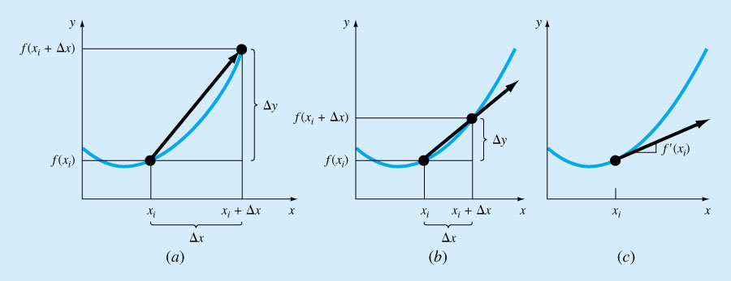
Differentiation
The finite difference becomes a derivative as Δx approaches zero.

Slide 6
Taylor Series Expansion
Non-elementary functions such as trigonometric, exponential, and others are expressed in an approximate fashion using Taylor series when their values, derivatives, and integrals are computed.
Any smooth function can be approximated as a polynomial. Taylor series provides a means to predict the value of a function at one point in terms of the function value and its derivatives at another point.

Slide 7
Numerical Application of Taylor Series
If f (x) and its first n+1 derivatives are continuous on an interval containing x_{i+1} and x_{i} , then:
Where the remainder R_{n} is defined as:
ξ is a value of x that lies somewhere between x_{i} and x_{i+1}.

Slide 8
Taylor Series ξ in the Remainder Term
Limitations
ξ is not exactly known but lies somewhere between x_{i} and x_{i+1}
To evaluate R_{n}, the (n+1) derivative of f (x) has to be determined. To do this f (x) must be known
if f (x) was known there would be no need to perform the Taylor series expansion!!!
Modification
R_{n} = O(h^{n+1}) the truncation error is of the order of h^{n+1 .} (h = x_{i+1} – x_{i})
If the error is O(h), halving the step size will halve the error.
If the error is O(h²), halving the step size will quarter the error.
In general, the truncation error is decreased by addition of more terms in the Taylor series.
Notes:
…………………………………………………………………………………………………………………………………………………………………………………………………………………………………………………………………………………………………………………………………………………………………………………………………………………………………………………………………………………………………………………………………………………………………………………………………………………………………………………………………………………………………………………………………………………………………………………………………………………………………………………………………………………………………………………………………………………………………………………………………………………………………………………………………………………………………………………………………………………………………………………………………………………………………………………………………………………………………………………………………………………………………………………………………………………………………………………………………………………………………………………………………………………………………………………………………………………………………………………………………………………………………………………………………………………………………………………………………………………………………………………………………………………………………………………………………………………………………………………………………………………………………………………………………………

Slide 9
Numerical Application of Taylor Series
The series is built term by:
Continuing the addition of more terms to get better approximation we have:
zero order approximation
1st order approximation
2nd order approximation

Slide 10
Forward Difference Formulas- 1st derivative
2nd order Taylor series expansion of f(x) can be written as:
Then, the first derivative can be expressed as:
Given that f“(x) can be approximated by:
(1)
(2)
(3)

Slide 11
Forward Difference Formulas- 1st derivative
Substituting equation (3) into equation (2):
Collecting terms and simplifying, we have:
Note that the inclusion of the second-derivative term has improved the accuracy to O(h²).

Slide 12
Forward Difference Formulas- 2nd derivative
Start with Lagrange interpolation polynomial for f(x) based on the four points x_{i}, x_{i+1}, x_{i+2} and x_{i+3} .
Differentiate the products in the numerators twice
Substitute x = x_{i} and consider the fact that x_{j} - x_{i} =(j- i)h
The expression of the second derivative is then:

Slide 13
Backward Difference Formulas- 1st derivative
Using backward difference in the Taylor series expansion,
And given that f “(x) can be approximated by:
The second-order estimate of f ’(x) can be obtained:

Slide 14
Backward Difference Formulas- 2nd derivative
Start with Lagrange interpolation polynomial for f(x) based on the four points x_{i}, x_{i-1}, x_{i-2} and x_{i-3} .
Differentiate the products in the numerators twice
Substitute x = x_{i} and consider the fact that x_{j} - x_{i} =(j- i)h
The expression of the second derivative is then:

Slide 15
Centered Difference Formulas- 1st derivative [O(h²)]
Start with the 2nd degree Taylor expansions about x for f(x+h) and f(x-h):
Subtract (5) from (4)
Hence
(4)
(5)

Slide 16
Centered Difference Formulas- 1st derivative [O(h⁴)]
Start with the difference between the 4th degree Taylor expansions about x for f(x+h) and f(x-h):
Use the step size 2h, instead of h, in (6)
Multiply equation (6) by 8, subtract (7) from it, and solve for f’(x)
(6)
(7)

Slide 17
Centered Difference Formulas- 2nd derivative [O(h²)]
Start with the 3rd degree Taylor expansions about x for f(x+h) and f(x-h):
Add equations (8) and (9), and solve for f’’(x)
(8)
(9)

Slide 18
Centered Difference Formulas- 2nd derivative [O(h⁴)]
Start with the addition between the 5th degree Taylor expansions about x for f(x+h) and f(x-h):
Use the step size 2h, instead of h, in (10)
Multiply equation (10) by 16, subtract (11) from it, and solve for f’’(x)
(10)
(11)

Slide 19
Error Analysis
Generally, if numerical differentiation is performed, only about half the accuracy of which the computer is capable is obtained unless we are fortunate to find an optimal step size.
The total error has part due to round-off error plus a part due to truncation error.

Slide 20
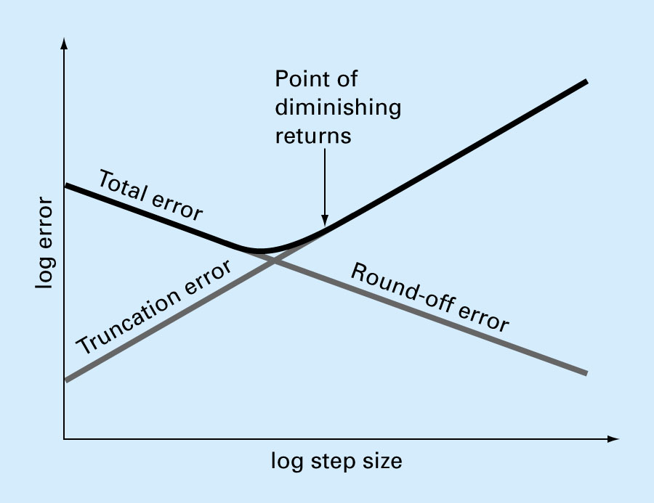
Total Numerical Error
Total numerical error = truncation error + round-off error.
Trade-off between truncation and round-off errors
Notes:
…………………………………………………………………………………………………………………………………………………………………………………………………………………………………………………………………………………………………………………………………………………………………………………………………………………………………………………………………………………………………………………………………………………………………………………………………………………………………………………………………………………………………………………………………………………………………………………………………………………………………………………………………………………………………………………………………………………………………………………………………………………………………………………………………………………………………………………………………………………………………………………………………………………………………………………………………………………………………………………………………………………………………………………………………………………………………………………………………………………………………………………………………………………………………………………………………………………………………………………………………………………………………………………………………………………………………………………………………………………………………………………………………………………………………………………………………………………………………………………………………………………………………………………………………………

Slide 21
Example 1
Estimate the first and second derivatives of:
at x = 0.5 and h = 0.25 using
forward finite-divided difference
Centered finite-divided difference
backward finite-divided difference?
Notes:
…………………………………………………………………………………………………………………………………………………………………………………………………………………………………………………………………………………………………………………………………………………………………………………………………………………………………………………………………………………………………………………………………………………………………………………………………………………………………………………………………………………………………………………………………………………………………………………………………………………………………………………………………………………………………………………………………………………………………………………………………………………………………………………………………………………………………………………………………………………………………………………………………………………………………………………………………………………………………………………………………………………………………………………………………………………………………………………………………………………………………………………………………………………………………………………………………………………………………………………………………………………………………………………………………………………………………………………………………………………………………………………………………………………………………………………………………………………………………………………………………………………………………………………………………………

Slide 22
Example 1 - Solution
Forward difference
1st derivative computation
The data needed is:
First derivative:
εt = 5.82%
True value=-0.9125
Notes:
…………………………………………………………………………………………………………………………………………………………………………………………………………………………………………………………………………………………………………………………………………………………………………………………………………………………………………………………………………………………………………………………………………………………………………………………………………………………………………………………………………………………………………………………………………………………………………………………………………………………………………………………………………………………………………………………………………………………………………………………………………………………………………………………………………………………………………………………………………………………………………………………………………………………………………………………………………………………………………………………………………………………………………………………………………………………………………………………………………………………………………………………………………………………………………………………………………………………………………………………………………………………………………………………………………………………………………………………………………………………………………………………………………………………………………………………………………………………………………………………………………………………………………………………………………

Slide 23
Example 1 - Solution
Second derivative computation
The data needed is:
Second derivative:
Notes:
…………………………………………………………………………………………………………………………………………………………………………………………………………………………………………………………………………………………………………………………………………………………………………………………………………………………………………………………………………………………………………………………………………………………………………………………………………………………………………………………………………………………………………………………………………………………………………………………………………………………………………………………………………………………………………………………………………………………………………………………………………………………………………………………………………………………………………………………………………………………………………………………………………………………………………………………………………………………………………………………………………………………………………………………………………………………………………………………………………………………………………………………………………………………………………………………………………………………………………………………………………………………………………………………………………………………………………………………………………………………………………………………………………………………………………………………………………………………………………………………………………………………………………………………………………

Slide 24
Example 1 - Solution
Centered finite-divided difference
The data needed is:
First derivative:
εt = 0%
True value=-0.9125
Notes:
…………………………………………………………………………………………………………………………………………………………………………………………………………………………………………………………………………………………………………………………………………………………………………………………………………………………………………………………………………………………………………………………………………………………………………………………………………………………………………………………………………………………………………………………………………………………………………………………………………………………………………………………………………………………………………………………………………………………………………………………………………………………………………………………………………………………………………………………………………………………………………………………………………………………………………………………………………………………………………………………………………………………………………………………………………………………………………………………………………………………………………………………………………………………………………………………………………………………………………………………………………………………………………………………………………………………………………………………………………………………………………………………………………………………………………………………………………………………………………………………………………………………………………………………………………

Slide 25
Example 1 - Solution
Backward finite-divided difference
The data needed is:
First derivative :
εt = 3.77%
True value=-0.9125
Notes:
…………………………………………………………………………………………………………………………………………………………………………………………………………………………………………………………………………………………………………………………………………………………………………………………………………………………………………………………………………………………………………………………………………………………………………………………………………………………………………………………………………………………………………………………………………………………………………………………………………………………………………………………………………………………………………………………………………………………………………………………………………………………………………………………………………………………………………………………………………………………………………………………………………………………………………………………………………………………………………………………………………………………………………………………………………………………………………………………………………………………………………………………………………………………………………………………………………………………………………………………………………………………………………………………………………………………………………………………………………………………………………………………………………………………………………………………………………………………………………………………………………………………………………………………………………

Slide 26

Richardson Extrapolation
Numerical derivation can be accurate by (a) Increasing turncation order and (b) Decreasing step size.
Richardson extrapolation uses two derivative estimates to compute a third, more accurate approximation
Richardson extrapolation
For centered difference approximations with O(h²), the application of this formula will yield a new derivative estimate of O(h⁴).

Slide 27
Example 2
Estimate the first and second derivatives of:
at x = 0.5 and h₁ = 0.5; h₂ = 0.25 using
Centered finite-divided difference and Richardson extrapolation
Notes:
…………………………………………………………………………………………………………………………………………………………………………………………………………………………………………………………………………………………………………………………………………………………………………………………………………………………………………………………………………………………………………………………………………………………………………………………………………………………………………………………………………………………………………………………………………………………………………………………………………………………………………………………………………………………………………………………………………………………………………………………………………………………………………………………………………………………………………………………………………………………………………………………………………………………………………………………………………………………………………………………………………………………………………………………………………………………………………………………………………………………………………………………………………………………………………………………………………………………………………………………………………………………………………………………………………………………………………………………………………………………………………………………………………………………………………………………………………………………………………………………………………………………………………………………………………

Slide 28


Example 2 - Solution
Centered finite-divided difference
Richardson extrapolation :
εt = 0%
True value=-0.9125
Notes:
…………………………………………………………………………………………………………………………………………………………………………………………………………………………………………………………………………………………………………………………………………………………………………………………………………………………………………………………………………………………………………………………………………………………………………………………………………………………………………………………………………………………………………………………………………………………………………………………………………………………………………………………………………………………………………………………………………………………………………………………………………………………………………………………………………………………………………………………………………………………………………………………………………………………………………………………………………………………………………………………………………………………………………………………………………………………………………………………………………………………………………………………………………………………………………………………………………………………………………………………………………………………………………………………………………………………………………………………………………………………………………………………………………………………………………………………………………………………………………………………………………………………………………………………………………

Slide 29



Finite Divided Difference Method
Divided differences is a recursive division process. The method can be used to calculate the coefficients in the interpolation polynomial in the Newton form.
The Taylor series used to approximate divided differences.
Taylor Series
First Forward Difference
Δf_{i} is referred to as the first forward difference and h is called the step size

Slide 30
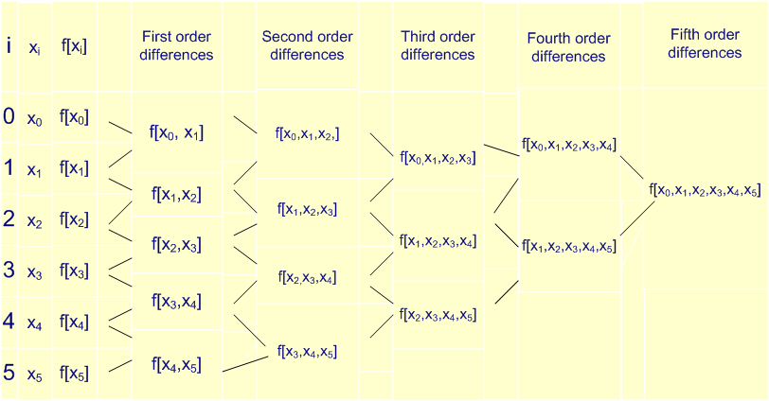
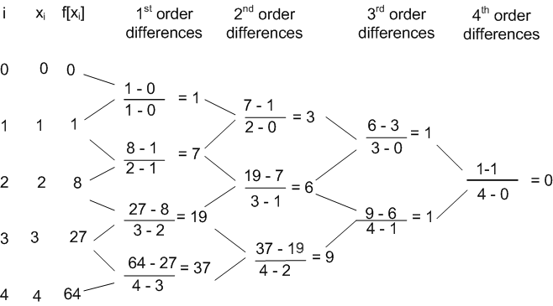
Finite Divided Difference Table

Slide 31
Example 3
Example: Compute f(0.3) for the data using Newton's divided difference formula.
x | 0 | 1 | 3 | 4 | 7
f | 1 | 3 | 49 | 129 | 813
Divided difference table
f(x) = f [x₀] + (x - x₀) f [x₀, x₁] + (x - x₀) (x - x₁) f [x₀, x₁, x₂] +
(x - x₀) (x - x₁) (x - x₂)f [x₀, x₁, x₂, x₃]
x_{i} | f_{i}
0 | 1
 |  | 2
1 | 3 |  | 7
 |  | 23 |  | 3
3 | 49 |  | 19
 |  | 80 |  | 3
4 | 129 |  | 37
 |  | 228
7 | 813
f(0.3) = 1 + (0.3 - 0) 2 + (0.3)(0.3 - 1) 7 +
(0.3) (0.3 - 1) (0.3 - 3) 3
=1.831

Slide 32


THANK YOU
Questions??

